Slide 1
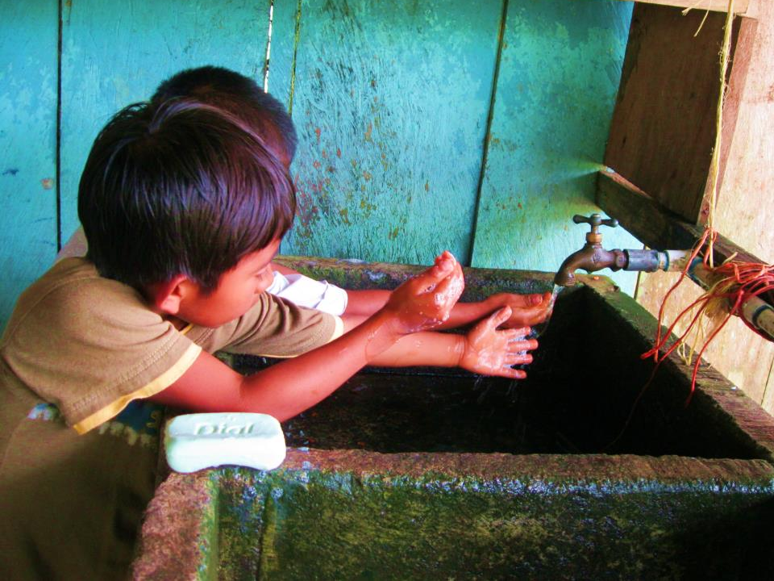
New Member Introduction to EWB-USA
Photo: EWB-USA Greater Austin Professional Chapter
Notes:
Notes to Facilitator (not intended as part of the presentation script):
This presentation is intended to provide chapter officers and leaders a resource to introduce new members to Engineers Without Borders USA. The presentation helps provide a common understanding of what and who we are as an organization, as well as describing the structure of the organization and what we do. New members will also have a better understanding of some of the roles they can play within the chapter and some of the skills and opportunities that arise from volunteering with EWB-USA.
Presentation script : Please note that where you see the term “presentation script” this indicates the script for facilitators to use when giving this presentation.

Slide 2
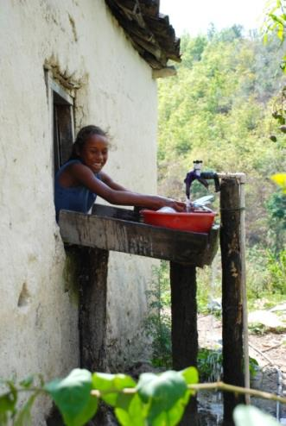
Presentation Outline
New Member Introduction to EWB-USA
What We Are
Who We Are
Our Structure
HQ
Regions
Chapters
Members
What We Do
Notes:
Presentation script
Here’s a quick look at what we’ll be covering in this presentation.

Slide 3
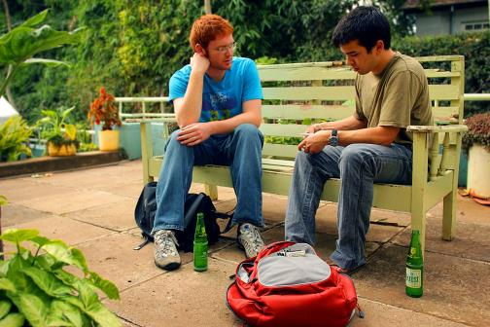
What We Are
Engineers Without Borders USA is a membership-based nonprofit organization that partners with communities to meet their basic human needs and creates global leaders through transformative experiences.
Notes:
Presentation script
Engineers Without Borders USA is a membership-based nonprofit organization that partners with communities to meet their basic human needs and creates global leaders through transformative experiences. EWB-USA was founded in 2002 with it’s first program in Belize. Since that time the organization has grown dramatically with chapters in almost every state and now almost 400 program worldwide.

Slide 4
THE EWB-USA MODEL
MISSION & VISION
MISSION
EWB-USA supports community-driven development programs worldwide through partnerships that design and implement sustainable engineering projects, while creating transformative experiences that enrich global perspectives and create responsible leaders.
VISION
EWB-USA's vision is a world in which the communities they serve have the capacity to sustainably meet their basic human needs.
2002
Year that EWB-USA was founded
International Community Programs
Community Engineering Corps
Engineering Service Corps
2.5 million
Lives impacted since 2002
Notes:
Presentation script
EWB-USA’s mission is based on more than blueprints and measurements; it is based on real relationships and five-year partnerships with communities. EWB-USA does more than build latrines for communities -- they equip them to build and maintain latrines themselves, which ensures that the community will have sanitation solutions long after our five-year commitment is fulfilled.
EWB-USA was founded in 2002 and since that time has developed three different program models which have impacted roughly 2.5 million people. We’ll talk more about our different program models later in the presentation.

Slide 5
Our Focus
Stronger Communities & Stronger Leaders
Build stronger communities
Build stronger global leaders
EWB-USA builds stronger communities by empowering them with the capacity to meet their basic human needs.
EWB-USA’s members collaborate with local partners to design and build sustainable engineering projects.
From classroom to field, EWB-USA offers its members transformative experiences that enrich global perspectives and produce better students and better employees.
This engagement teaches skills, such as:
Leadership
Project Management
Cross-cultural Communication
Systems Thinking
Notes:
Presentation script
EWB-USA spearheads a movement of more than 14,700 incredibly resourceful and driven members that have the knowledge and willingness to help build a better world. Our chapter is one of hundreds across the US. We all share a commitment to community partners and the idea of building stronger global leaders within our membership.
As a new member you can build these skills by participating on a design team, helping to plan a fundraiser or working with a seasoned professional mentor on our project team. (NOTE TO FACILITAOR: Please adapt to fit teams and committees within your chapter)

Slide 6
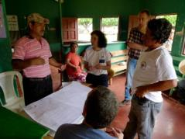
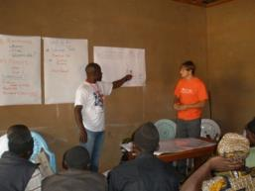
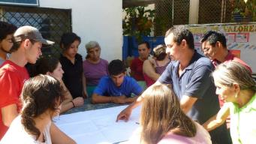
Who We Are
By the Numbers
EWB-USA Includes:
Partnering communities
In 39 countries
389 programs
Chapters
Over 280 chapters
Members
Over 14,700 members
Students
Faculty
Professionals
Engineers
Non-engineers
Donors and supporters
One organization
Notes:
Presentation script
EWB-USA works in 39 countries around the world, including in the U.S. and has almost 400 programs. Our programs have impacted approximately 2.5 million people and we continue to look for community-driven programs where we can make a five year commitment to communities internationally as well as through the Community Engineering Corps here at home.
Two-thirds of our chapters are based at universities and colleges while nearly a third are regionally located and made up primarily of professionals who have joined the organization. Of our nearly 15,000 members about 70% are student members and the other 30% are professionals. Together though, students, professionals, donors and staff we make up ONE organization.

Slide 7
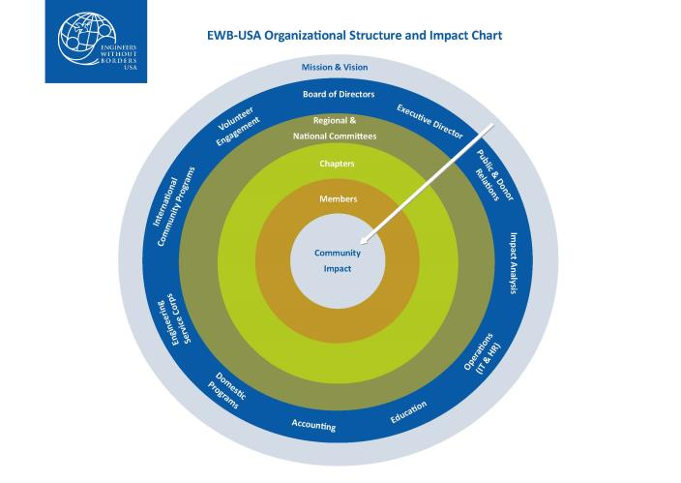
How We’re Structured
Notes:
Presentation script
Engineers Without Borders USA is made up of a Board of Directors which includes a student and professional member representative. The Executive Director and headquarters staff are made up of about 20 full time employees are based in Denver, Colorado. EWB-USA is organized into seven regions across the US and each of these is headed by a steering committee made up of student and professional members.
We also have a number of regional and national committees focused on three main roles:
Supporting volunteer engagement
Providing oversight and technical review
Developing technical resources
Finally, the core of our structure is centered on successful community outcomes and sustainability. Our chapters are a fundamental aspect of our ability to support this core feature and are filled with student and professional members from across the spectrum of engineering and non-engineering studies and fields of expertise.

Slide 8
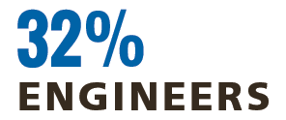
EWB-USA HQ
The full-time staff members at EWB-USA’s headquarters in Denver, Colo., facilitate a robust quality assurance and quality control process that enables our chapters to work on hundreds of high-quality, sustainable projects that are community-initiated across the globe each year.
The roles they play include:
Provide education and guidance on each stage of a project’s development
Review all project designs for technical and sustainable feasibility
Train chapter project teams for fluency in EWB-USA policies, project process and travel requirements
Ensure proper financial governance is maintained over all funds associated with the organization, including our 280+ chapters
100%MISSION-DRIVEN
Notes:
Presentation script
Members, chapters and projects are supported by EWB-USA Headquarters staff. To ensure quality control and quality assurance of all projects, each EWB-USA project is supported by professional engineers and other staff that assist the chapter in ensuring that a safe, well-designed and sustainable project will be implemented with the partnering community.
HQ staff work with chapters and regions on member engagement providing guidance on EWB-USA policies, training opportunities and support for chapters to operate more effectively. HQ staff also work with individual and corporate donors to provide grant opportunities for projects and help cover the cost of QA/QC, liability insurance and other operational costs.

Slide 9
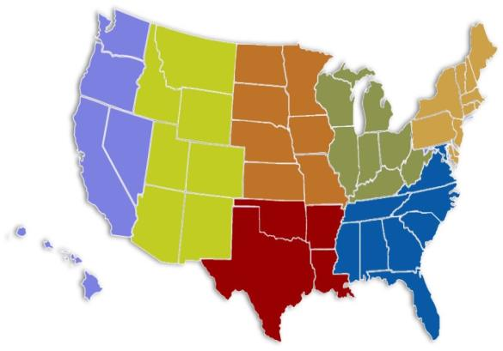
EWB-USA Regions
Seven Regions:
West Coast, Mountain, South Central,
Midwest, Great Lakes, Northeast, Southeast
http://regions.ewb-usa.org/
Notes:
Presentation script
EWB-USA is made up of 7 regions which you can see on the slide.
Each region has a steering committee which is a volunteer leadership body consisting of an executive committee and representatives from each of the states within the region. To learn more about the purpose of the committee you can visit our website listed on the slide.
In addition, there is the Council of Regional Presidents (CORP) that include all the Presidents from the 7 regions. This group helps to facilitate collaboration and best practice sharing among regions and often provides insight and recommendations to HQ regarding policy changes and strategic planning.

Slide 10
EWB-USA Chapters
Student
Officers & Other Leadership Roles
Project Teams & Committees
Professional
Officers & Other Leadership Roles
Project Teams, Mentors & Committees
Notes:
Presentation script
Chapters are a central component of how EWB-USA operates and is really the place where the organization connects dedicated volunteers with community partners around the world. Unlike the Peace Corps or similar organizations, we do not do any overseas placements. All of our work in partnering with communities happens at our chapter level.
Chapters are the focal point for enabling volunteers to work on projects, connect with communities and build and harness the skills needed to carry out the work of the organization.

Slide 11
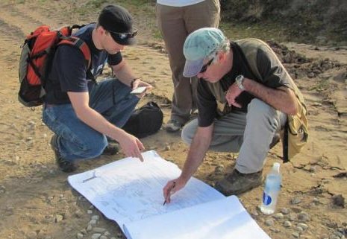
Roles and Opportunities
Chapter Roles
Chapter officer
Project Lead
Mentor
Fundraising Chair
PR Chair
Membership Chair
Event Planning Chair
Others… create the roles your chapter needs!
Notes:
Presentation script
There are a number of specific roles within a chapter. Chapter officers (President, Vice-President, Secretary, and Treasurer, as well as Faculty Advisors for student chapters) serve as the main point of contact for the chapter. Chapter officers represent their chapter and EWB-USA.
Beyond the primary chapter leadership roles like president or treasurer, we rely on members to get the work of the chapter done. This means there are opportunities for project related roles like helping to review designs and staying in contact with community partners, but it also means that there are vital non-project specific roles that need to be filled and without which projects and community partnerships can’t succeed. These are things like helping plan and organize fundraisers, making sure our own community and donors understand the work we’re doing.
Note to facilitator- Please describe the roles within your chapter or roles you hope to create and fill.

Slide 12
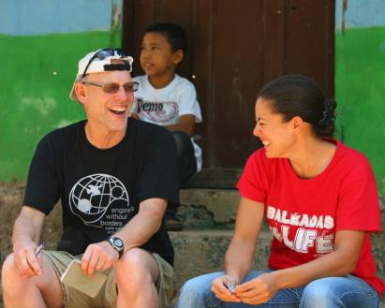
EWB-USA Membership
Student
Professional
Sign up online to become a member!
Track active members
Membership Dues
Travel team members, officers, discounted rates at educational events
Liability Insurance – Errors & Omissions
Notes:
Presentation Script
Engineers Without Border USA volunteers join as student or professional members by signing up online from the organization’s website. Signing up as an official member is important for several reasons.
Firstly, it helps our chapter better track our members and make sure we know who is part of the chapter. It also makes sure that all of our members have access to the password protected part of EWB-USA’s website, the myEWB-USA pages. This is area has a lot of the resources we use for our projects, fundraising and PR. Joining allows you to connect with other members and chapters as part of a larger organization with thousands of members. Our members are not only civil engineers, but come from other engineering backgrounds as well as members who are not engineers at all.
Professional members only: 20% of your annual membership due goes to help support the chapter.
As individual members it not only allows you to access resources from the website, but it’s also required to be able to be part of a project travel team. Official EWB-USA members are covered by liability, or errors and omissions insurance on approved EWB-USA projects. It also makes you eligible for discounts at EWB-USA events, like regional or national conferences put on by EWB-USA.
Finally, please keep in mind that by signing up online you allow the organization to highlight that we have a large set of talented and dedicated members. This helps us better make the case to donors for more support and can lead to more grant funding, more scholarships for events and more general funding to increase our capacity and program opportunities.

Slide 13
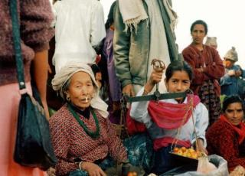
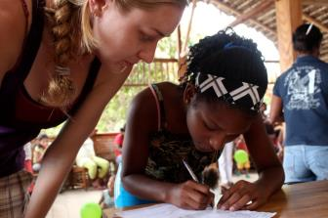
Skills & Benefits
What You Bring and Gain As a Member
Leadership and project management skills
Hands on field engineering
International travel experience
Language and cultural skills
Professional skills- technical writing, public speaking, cross-cultural communication
Client service/community needs approach
Recognition for your contribution
The satisfaction of contributing to building a better world.
Notes:
Presentation script
Our members come to the organization with a lot of skills and dedication. It’s also the case that EWB-USA can help build its members skills to help them prepare for a career or make career transitions. Here are some of the skills and experiences you may gain as an active member.

Slide 14
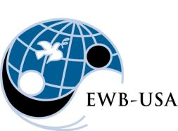
What We Do
International Community Programs
Domestic Projects through the Community Engineering Corps (CEC)
Engineering Service Corps
Notes:
Presentation script
International Community Programs (ICP) is EWB-USA’s oldest and best known program. This is probably what you think of when you think of what we do as an organization. These are the community-driven programs that culminate in a 5-year partnership with local communities around the world. The scope of these programs and projects is diverse, ranging from the construction of a health clinic in Peru to the implementation of household biosand filters in Cameroon.
Note to facilitator- feel free to use your own chapter’s program(s) as an example.
The Community Engineering Corps (CEC) is EWB-USA’s mechanism for doing work here in the USA. In February 2014, the Community Engineering Corps (CEC) was launched as an exciting new alliance between Engineers Without Borders USA (EWB-USA), the American Society of Civil Engineers (ASCE) and the American Water Works Association (AWWA). The CEC harnesses the expertise of thousands of volunteers by providing pro bono engineering services that address the infrastructure needs of underserved communities in the United States.
The CEC works collaboratively with communities to design solutions to problems that the community has identified. The CEC only partners with communities that do not have the financial resources to access engineering resources in a traditional manner.
EWB-USA's Engineering Service Corps offers the expertise of our most seasoned volunteers to organizations in the international development sector. We collaborate with NGOs and governments who use a community-driven approach and who lack access to the resources needed to design sustainable and appropriate solutions to engineering challenges. The Engineering Service Corps performs a variety of services, including engineering studies, owner's representation, planning, design, and monitoring and evaluation.

Slide 15
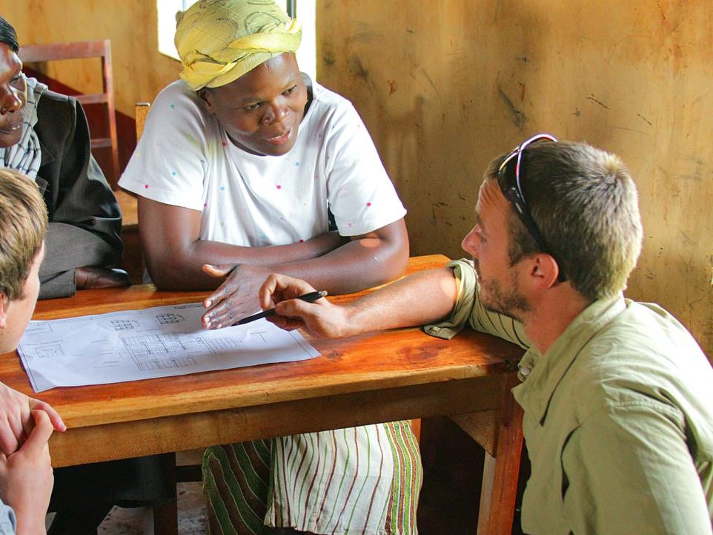
Welcome Abroad
Questions & Answers
Photo: EWB-USA Montana State University Chapter
Notes:
Presentation script
Let’s take a little time for any questions you may have.
Also at this time help new member to sign up online at your chapter meetings so they can access the many resources available on the EWB-USA website (www.ewb-usa.org).

